Slide 1

Digital Egypt Pioneers Initiative
BUILDING A SMALL BUSINESS NETWORK
supervised by: Eng. Mohamed Ramadan
T

Slide 2
TEAM MEMBERS
1- Helmy Gaballah
2- Muhammed Ashraf
3- Mohamed Abdel fattah
4- Mohamed Ahmed Mohamed FAthi
5- Khaled Rayhan
6- Yousef Taha

Slide 3

An enterprise network, a growing small business, requires a robust and scalable network infrastructure to support their main office and remote office operations. This presentation outlines the network design, implementation, services, and management to meet their connectivity, security, and performance needs
INTRODUCTION

Slide 4


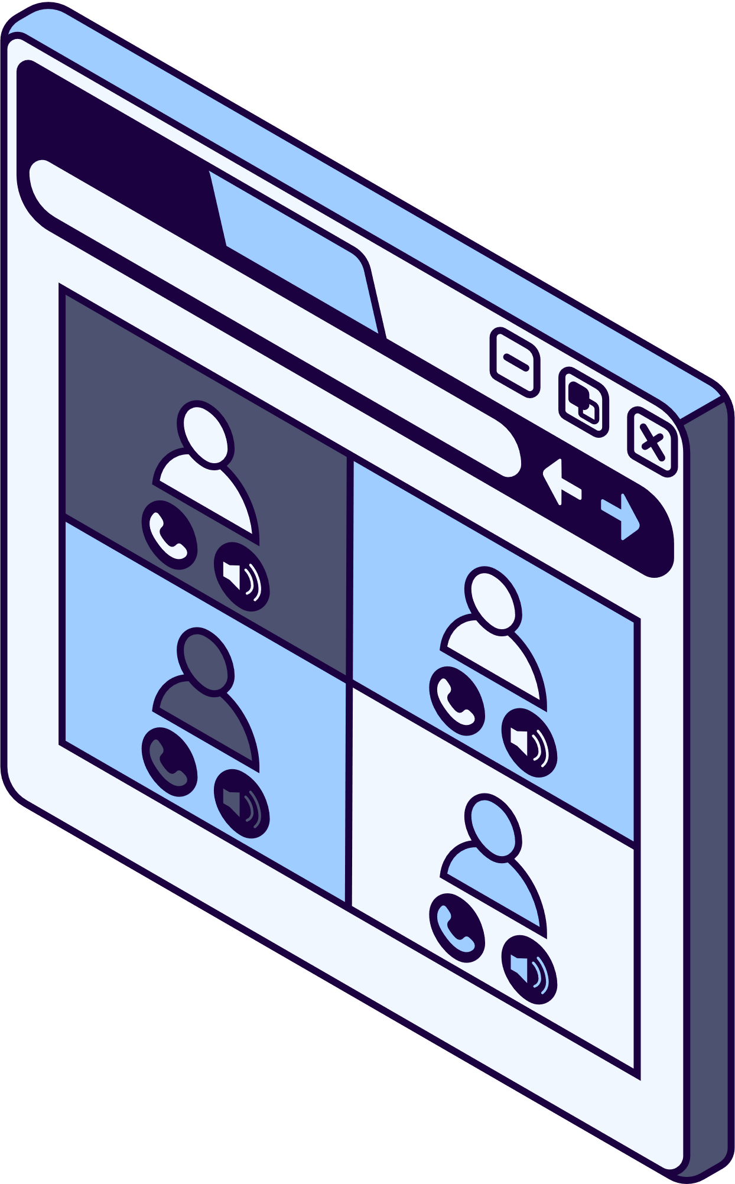
TOPICS
Network Design
Network Implementation
Network Services
Troubleshooting

Slide 5


NETWORK DESIGN:
1- Addressing:
Assign IP addresses to each network using a private IP address range (e.g., 192.168.1.0/24, 192.168.2.0, 192.168.3.0 192.168.4.0)
2- VLAN:
-Create separate VLANs for different departments (e.g., Sales, IT, HR)
to improve security and performance
3- Assign Vlan to each department:
-IT Department: Vlan 10 with range (192.168.10.0)
-HR Department: Vlan 20 with range (192.168.20.0)
-Sales department: Vlan 30 with range (192.168.30.0)

Slide 6
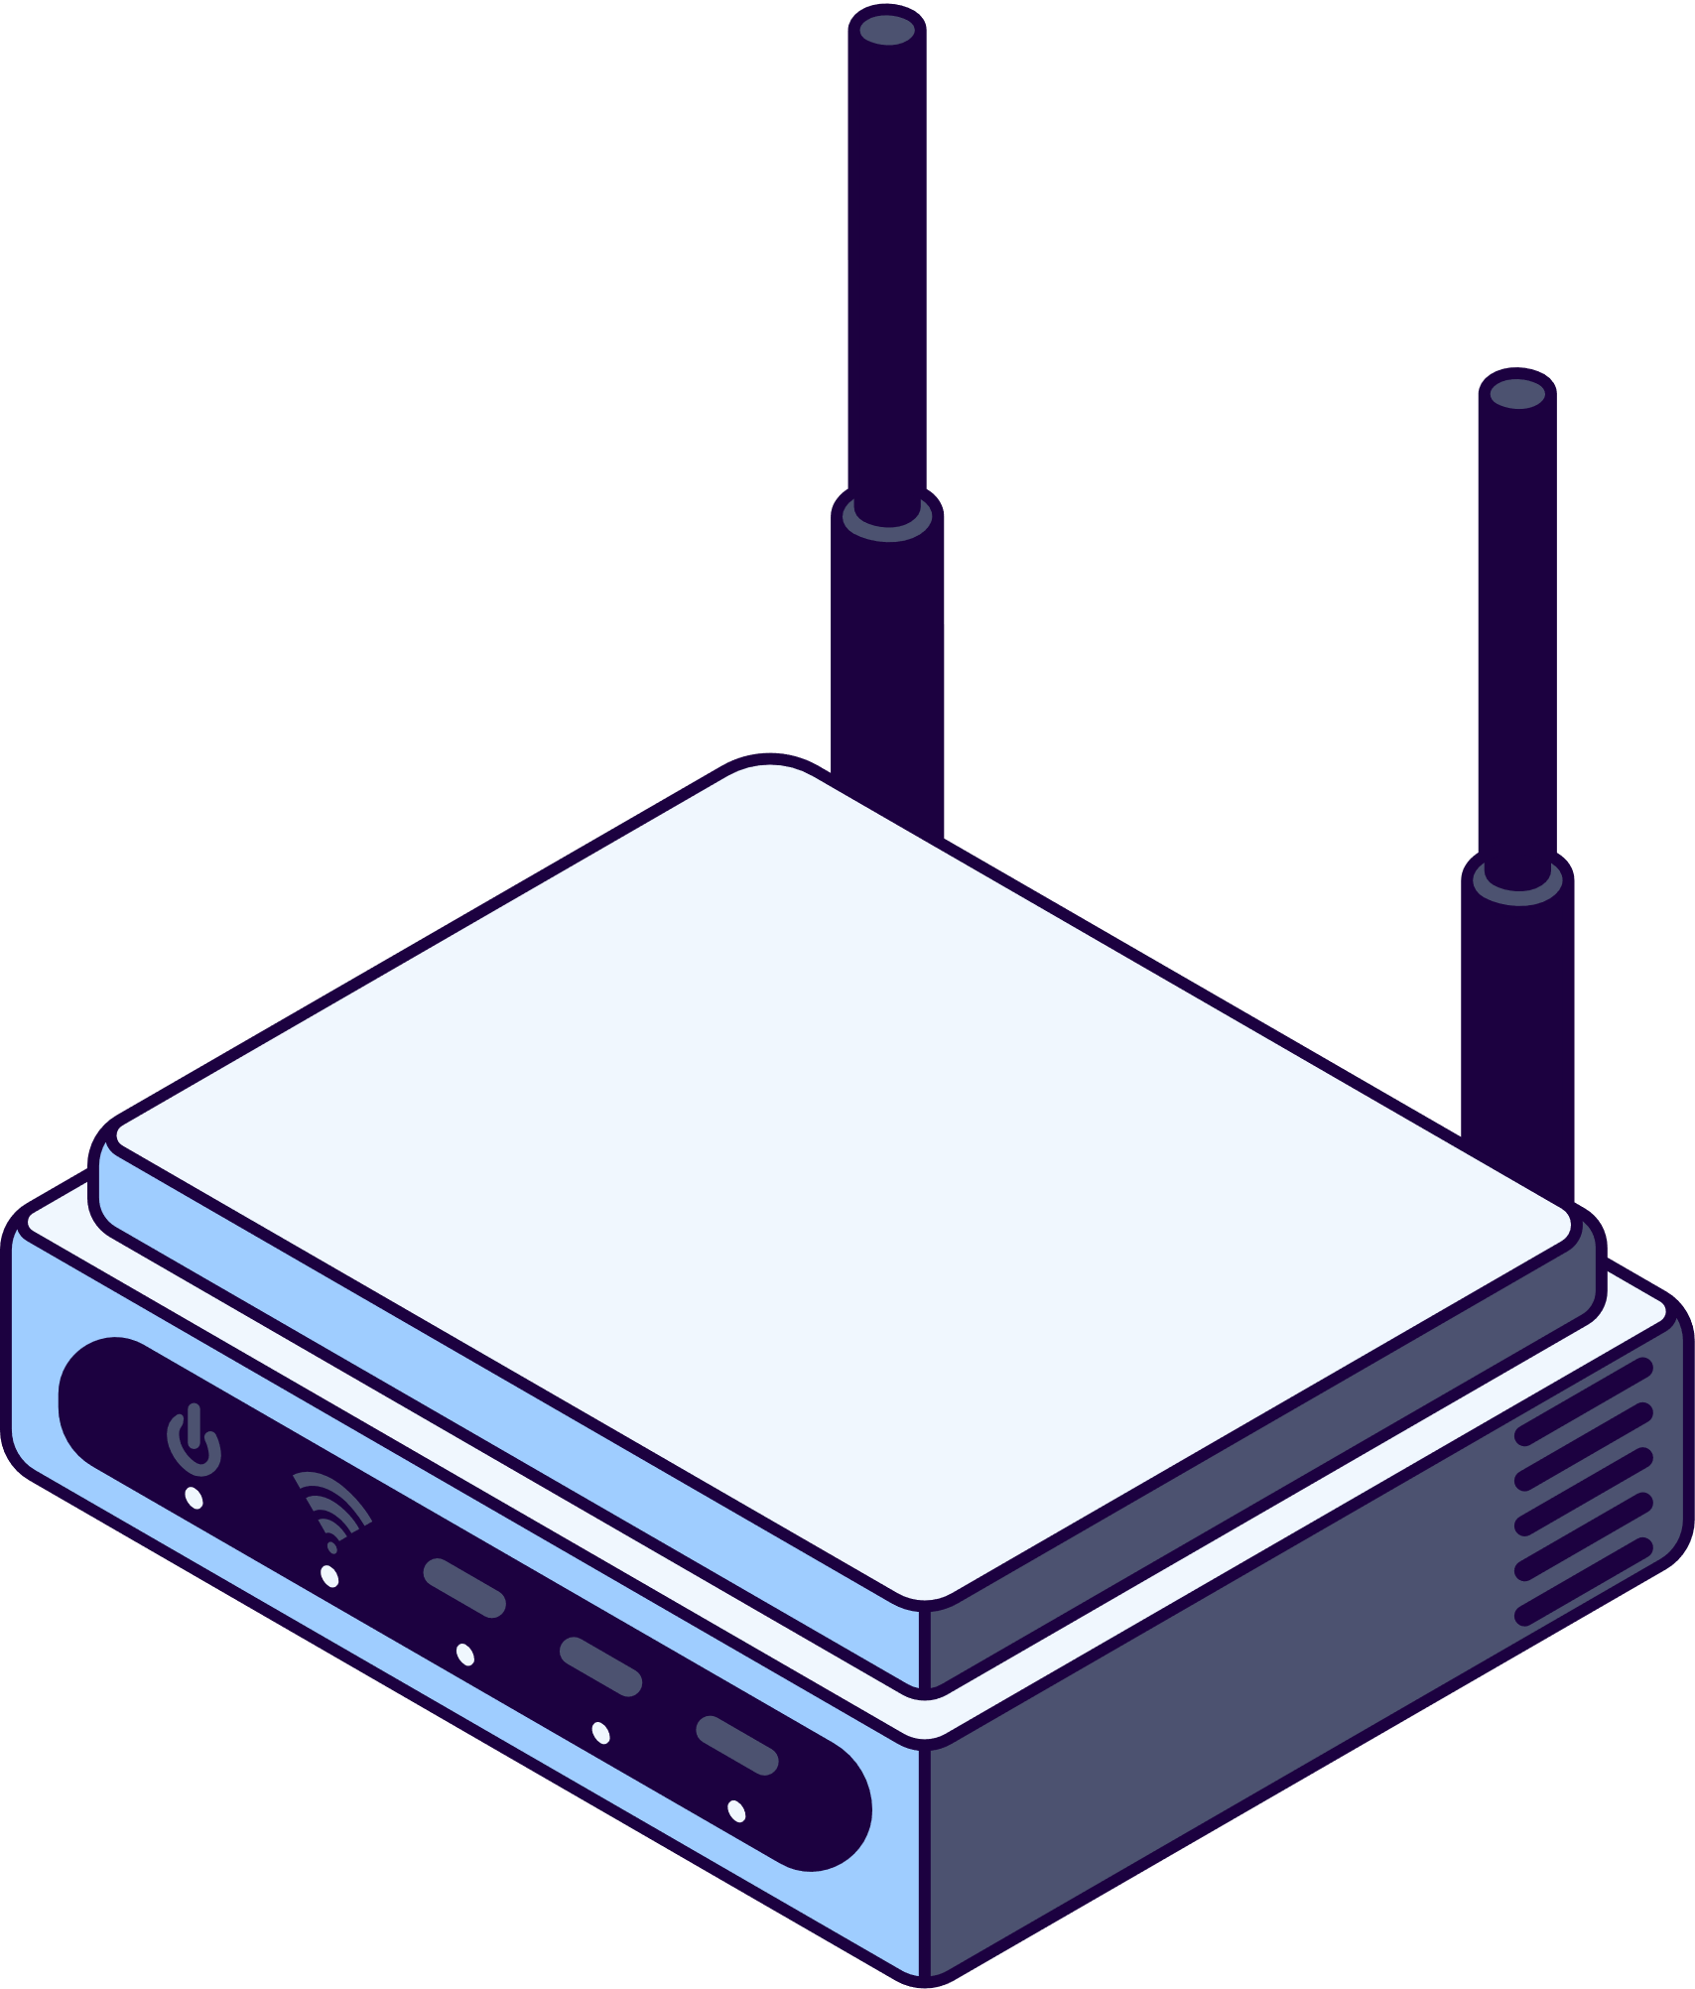
NETWORK IMPLEMENTATION
1- Device Configuration
Configure devices with necessary network settings:
IP Addressing: Ensure devices are assigned proper IP addresses (either static or via DHCP).
VLAN Setup: Assign devices to their respective VLANs.
Routing Protocols: Implement routing protocols such as OSPF between routers for efficient data flow.
2- Hardware Setup
Connect the routers, switches, computers, printers, and servers
3- Testing
Conduct a series of network tests to ensure functionality:
Ping and Traceroute to verify connectivity.

Slide 7

NETWORK SERVICES
1- DHCP (Dynamic Host Configuration Protocol)
Set up a DHCP server to automatically assign IP addresses to devices, simplifying network administration.
2- DNS (Domain Name System)
Configure DNS services to resolve hostnames into IP addresses, ensuring that devices can communicate using easy-to-remember names.
3- Security
Implement Access Control Lists (ACLs) on routers to limit access based on IP, port, or protocol.

Slide 8


Troubleshooting
Troubleshooting
Establish a troubleshooting protocol to quickly resolve issues such as:
Connectivity problems (e.g., ping failures).
Slow network performance due to excessive bandwidth usage or misconfigured devices.
Use diagnostic tools like Wireshark for packet analysis and SNMP for device management.

Slide 9
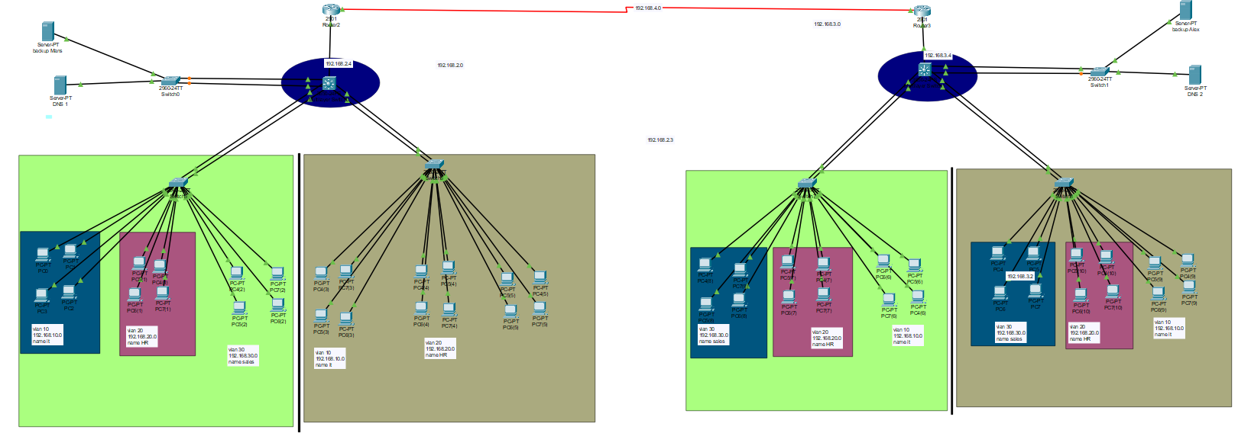
Network Topology Design in Cisco Packet Tracer

Slide 10
Thank
you!

